Slide 1
Pre-Congress: June 18, 2025
Main Congress: June 19-21, 2025

Slide 2
YOUR MEETING YOUR PROGRAM!
Showcasing Asian Aesthetics
Invited faculty: ‘best rated’ speakers across all ISAPS events of the last two years
Rest of the program selected from a competitive peer-reviewed abstract submission process
* Special rates for ISAPS members

Slide 3
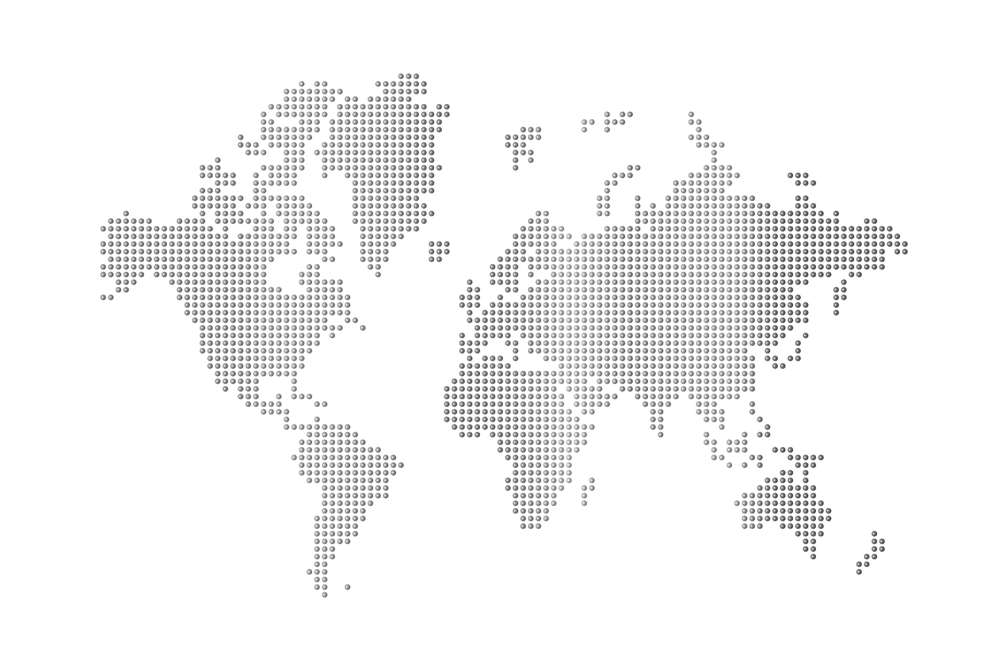
RENEW OR BECOME A MEMBER
www.isaps.org/membership/applying-to-join-isaps/
Residents can join for free, for up to three years.

