Slide 1

How to use the
ISAPS World Congress Singapore 2025
Social Media Toolkit
https://www.isaps.org/education/events/olympiad-singapore-2025/

Slide 2

ISAPS Olympiad World Congress
Background
As the largest aesthetic plastic surgery community, ISAPS is committed to global education, aligned to our objective for safe aesthetic procedures and improved quality of life for all patients worldwide.
Our delegates will experience the science behind aesthetic surgical and non-surgical treatments, technical pearls, live surgeries, new technologies and innovations, how to deal with possible complications, patient safety panels, business school, and Leadership Insights for Transformation (L.I.F.T) program alternatives as part of a dynamic program for knowledge interchange.
The ISAPS Olympiad World Congress takes place every two years in odd years, while the ISAPS World Congress is celebrated in even years. The next event will be the 2026 ISAPS World Congress Mexico.
Ways to help promote the ISAPS Olympiad World Congress 2025 on social media
Follow us on the following social media channels:
Facebook https://www.facebook.com/isapsplasticsurgeons Twitter https://www.twitter.com/isapsofficial
Instagram https://www.instagram.com/isapsplasticsurgeons/
Youtube @isapsplasticsurgeons
LinkedIn https://www.linkedin.com/company/isapsplasticsurgeons
Remember to use our event-hashtag #isaps2025!
Repost relevant published information on our official pages
Share our campaigns, materials and content.

Slide 3
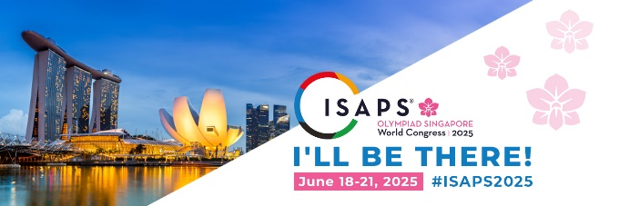
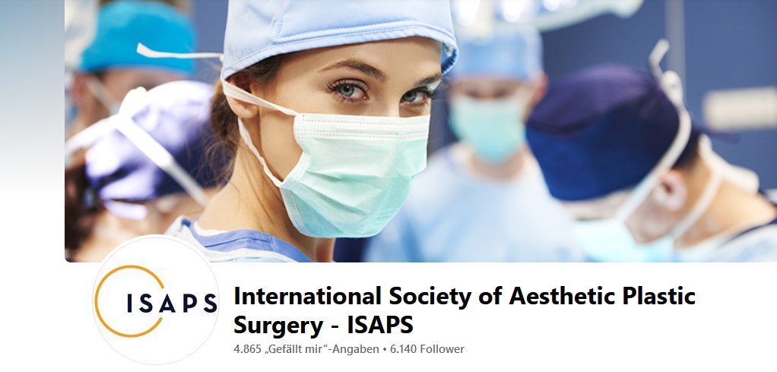
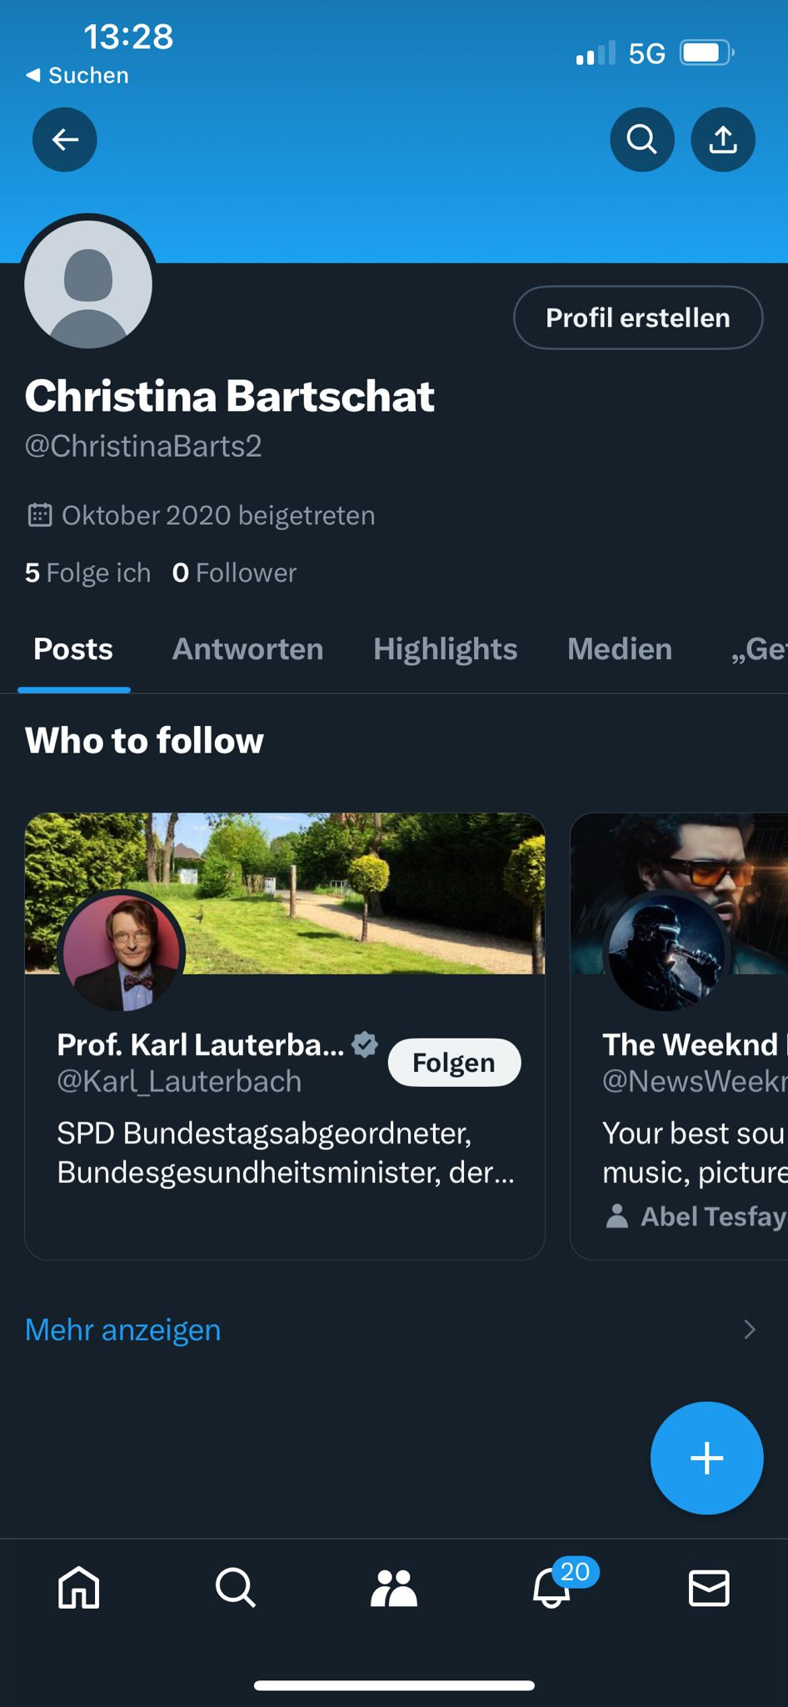




Personalise
your own account:
Personalize
your own account
You can find images for
Cover images (Facebook, X and LinkedIn)
Photo frame for your daily posts (Facebook, X, LinkedIn and Instagram)
Profile Frame for your profiles (Facebook, X, LinkedIn and Instagram)
Logo Image to personalize your chat groups (WhatsApp, WeChat, Telegram)
Where to download the Cover Image on the ISAPS Olympiad World Congress 2025 website:
https://www.isaps.org/media/gw5gucux/cover-images.zip
You can find images for Cover Image
(formatted for Twitter, Facebook and LinkedIn);
You can also find Photo Frame for your daily posts (formatted for Twitter, Facebook and LinkedIn);
You can also find a Profile Frame for your Facebook profile;
You can also find a Logo Image to personalize your Whatsapp/WeChat/Telegram etc. groups.
Facebook
Twitter
LinkedIn

Slide 4












Personalise
your own account:
Where to download the Photo Frame on the ISAPS Olympiad World Congress 2025 website:
https://www.isaps.org/media/0xxj0bfz/photo-frame.zip
Where to download the Animated GIF on the ISAPS Olympiad World Congress 2025 website:
https://www.isaps.org/media/yrnduhhu/gif_singapore.zip
You can find images for Cover Image
(formatted for Twitter, Facebook and LinkedIn);
You can also find Photo Frame for your daily posts (formatted for Twitter, Facebook and LinkedIn);
You can also find a Profile Frame for your Facebook profile;
You can also find a Logo Image to personalize your Whatsapp/WeChat/Telegram etc. groups.
Utilize the GIF format when engaging through comments on Facebook.
GIFs work well for quick reactions and interactive responses within comments.
Opt for the MP4 format if you intend to share the content on your personal profiles.
MP4 files are more versatile and suitable for sharing across various social media platforms.

Slide 5
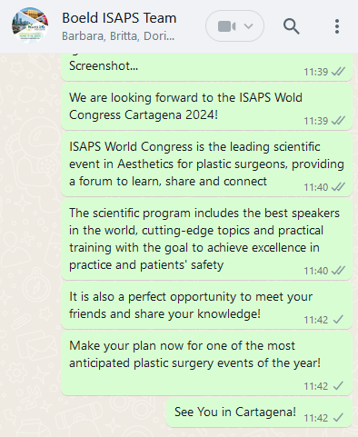



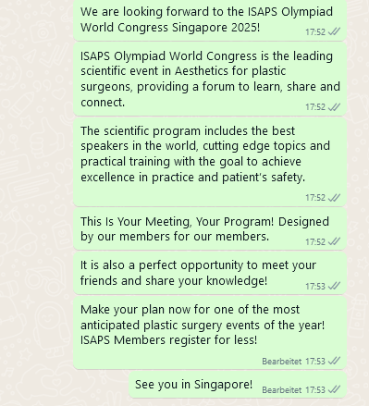




Where to download the Group Chat Image on the
ISAPS Olympiad World Congress 2025 website:
https://www.isaps.org/media/pm3h0rv0/group-chat.zip
ISAPS Olympiad
World Congress

Slide 6
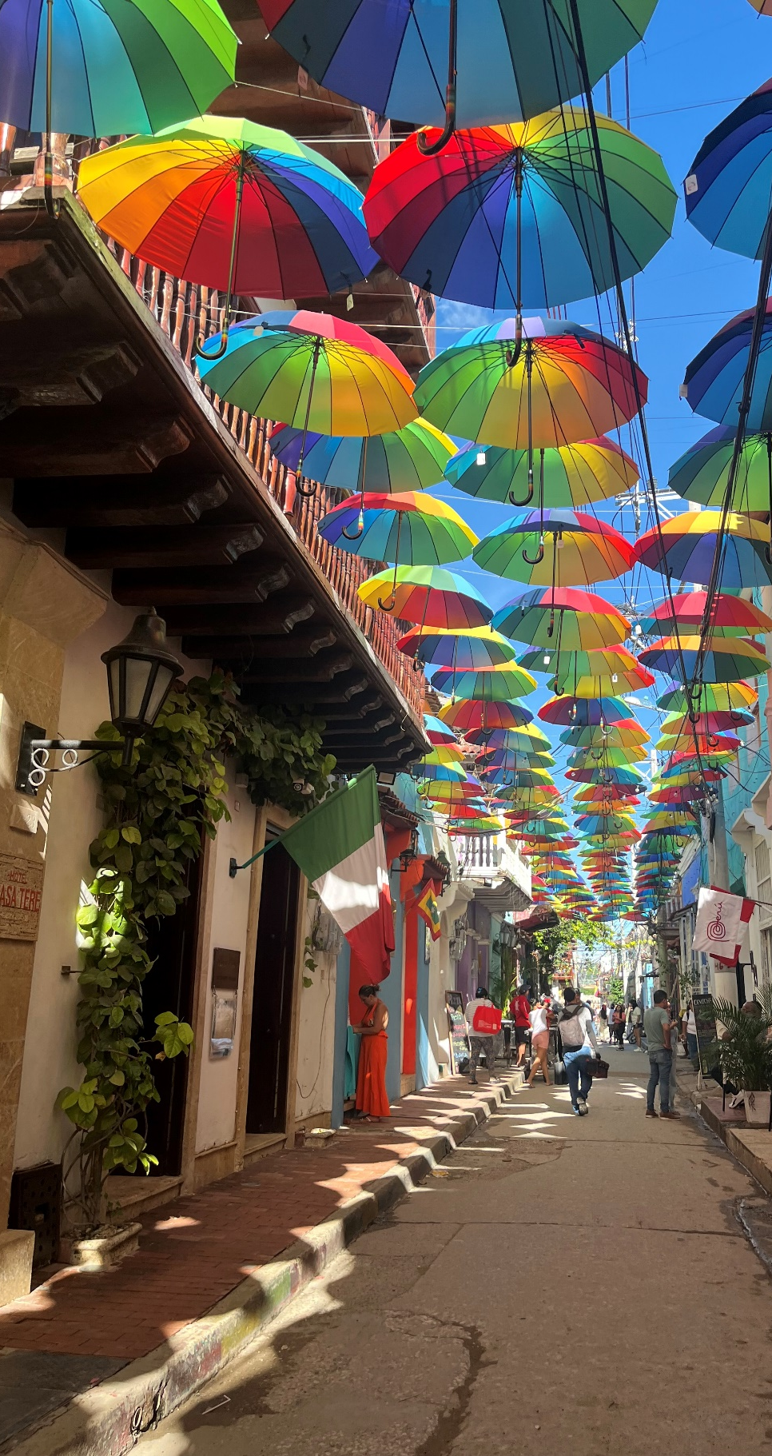
IF YOU HAVE
SUBMITTED YOUR ABSTRACT /
ARE FACULTY OF THE CONGRESS /
ALREADY REGISTER TO ATTEND
- Share that you have submitted an abstract about (topic) in your social media channels (Facebook, Twitter, LinkedIn, Instagram) and that you are attending #isapsc2025.
You can also record a video on your own social media channels and encourage delegates to come to your lecture.
Where to download the Social Media Abstract Submitter Images on the ISAPS Olympiad World Congress 2025 website: https://www.isaps.org/media/2dmpnyr5/i-have-submitted-my-paper.zip
- Share that you are going to be faculty of the congress!
You can also record a video on your own social media channels and encourage delegates to come to your lecture.
Where to download the Social Media Speaker Images on the ISAPS Olympiad World Congress 2025 website: https://www.isaps.org/media/3cgho5uo/isaps_singapore_some_kit_v2_5.jpg
- Share that you have already registered and what you are looking forward to!
You can also record a video on your own social media channels and encourage colleagues to attend the congress
Where to download the Cover Image on the ISAPS Olympiad World Congress 2025 website: https://www.isaps.org/media/gw5gucux/cover-images.zip

